Slide 1

MSC AUTOMOTIVE ENGINEERING
Topic
AI ETHICS
7080MAA - CONNECTED AUTONOMOUS VEHICLE CONTEXUALISATION
Created & Presented By:
SHIBAM GHOSAL
SID - 15460424

Slide 2

AI Ethics
Overview:
Reasons for the selection of this topic.
Present & Future challenges with the topic.
Importance to Connected Autonomous Vehicles.
Significance of the topic to my future work, and successful implementation in the industry.
Ethical implications to the community, environment, etc.

Slide 3


Slide 4
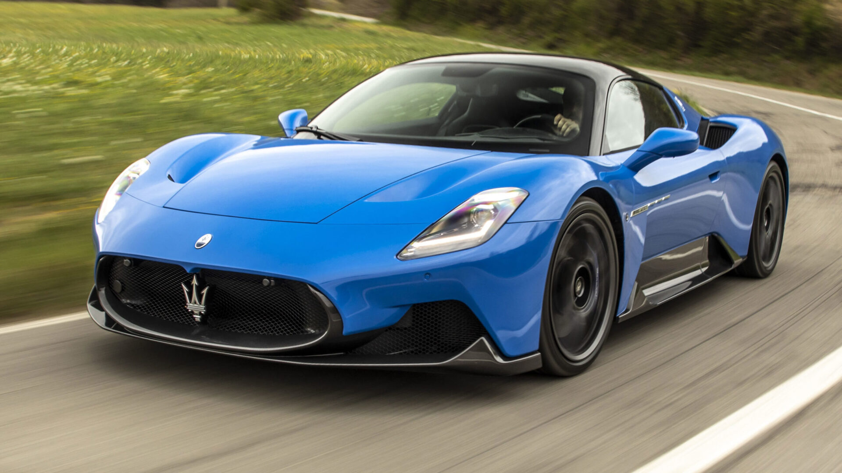

Slide 5


Slide 6
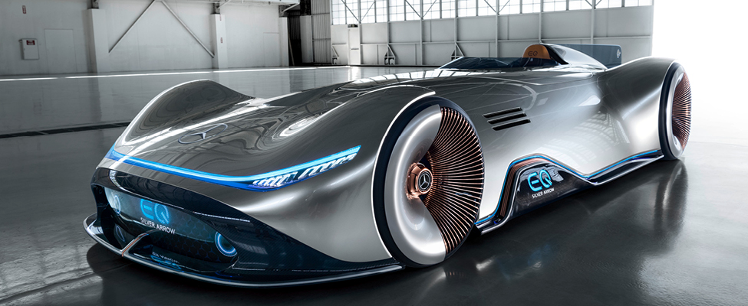

Slide 7
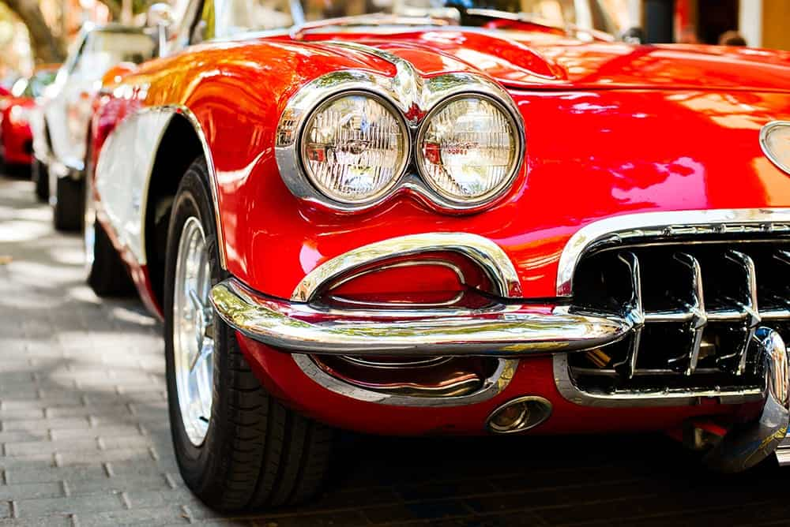

Slide 8

REFERENCES
Images for the making of slides:
https://www.moneybeach.co.uk/the-boardwalk/the-best-places-to-see-classic-cars-in-the-uk/
https://www.carwow.co.uk/best/best-supercars#gref
https://www.istockphoto.com/photos/ai
https://ats.net/en/focus-ai-artificial-intelligence-and-the-new-doomsday-machine/
https://www.ukposters.co.uk/fast-red-car-v127588
https://www.youtube.com/watch?app=desktop&v=_adJBzQgfsg
Research Materials:

